Slide 1

Weather Prediction Modelling for sensor placement
Contributors: Jeremy Cryer, Alec Anderson
University of San Diego: AAI-510
Professor: Som Shahapurkar
June 26, 2023

Slide 2


Problem Statement and Impact
There is a need to understand what climate conditions are and will be. The need for this is to have proper warning to a big storm or possible climate changes, such as rainfall, far enough in advance to be aware of some of the following:
Possible natural disasters
Flooding
Rain fall for irrigation systems
Impact:
Society Awareness
Danger Prevention
Increased Knowledge in Standard Weather Patterns.

Slide 3
Possible Solution options
Option 1
Option 2
Predictive modelling using historical data to identify future trends.
Uses historical data to predict trends and will adjust predictions based on incoming data.
Based on historical data, a trend can predict potentially future conditions far enough in advance.
Real time monitoring to identify drastic changes.
Uses real time monitoring devices to identify climate conditions.
Based current patterns, a storm can be identified, however the window for preventative measures is small.

Slide 4
Final Recommendation
Option 1: Predictive Modeling
Will provide the largest window for preventative measures to incoming stores.
With the constant flow of new data, historical trends can continue to evolve the model.
Real-time monitoring only, only helps alert incoming stores, not predict them.
Modeling can be taught and assessed prior to implementation, while monitor has to be assessed during implementation for accuracy.

Slide 5
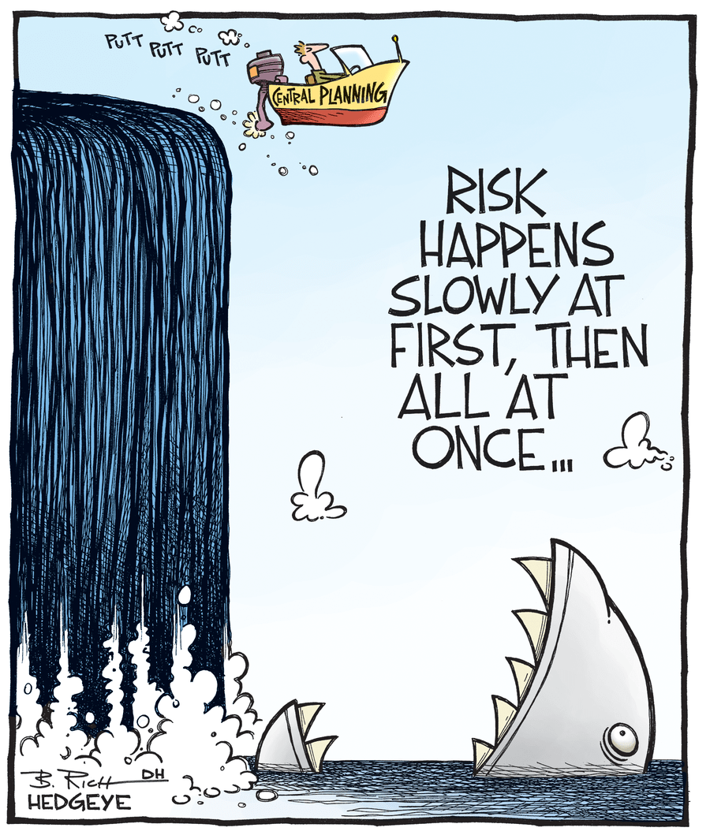
The Risks Involved
Operational
Model was taught with data missing units.
To get continuous data for learning and adjusting, sensors and IOT devices need to be installed in areas desired.
Ethical
Potential for false predictions could induce society panic.
Any IOT devices installed in a location could be assumed to impede privacy.
Regulatory
Government buy-off needs to be understood as these models will potentially affect society.

Slide 6
Mitigation Strategy
Operational
Once model accuracy is validated, Use known metric data to reassess.
Ethical
Properly test and run active pilots with results listed and posted for public view.
Disclaimers can be placed on the devices used to ensure no ethical violation.
Regulatory
Make a proposal once model is validated to take to the governing officials for approval in the area desired for implementation.

Slide 7

Lessons Learned and Future Implementation
This model creation was just a proof of concept and 1st iteration. To implement for actual solution implementation will involve some of the following learnings applied.
Use data with known metrics to reteach model.
Add algorithms to use known data for the creation of new calculated variables such as air pressure.

